Slide 1
Smarter HANA migration
Optimising UAT
22 November 2016
George Wilson

Slide 2
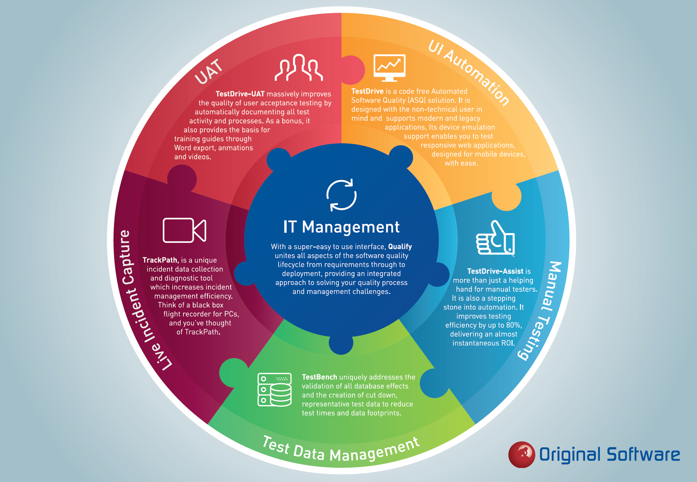

Slide 3
What the Analysts say
Where Original is unique is in comprehensively tackling the issues around data in testing’
Strengths
In addition to general QA scenarios, the vendor supports both SAP and Oracle E-Business Suite (EBS) testing (including predefined test packs), and is one of the few vendors to support IBM iSeries.
Customers consistently report that Original Software offer ease and high productivity via a code-free approach and process to migrate from manual to automated testing.
Original’s ability to migrate a manual test to an automated test automatically is also unique
..can also be used in agile processes more easily than other functional test automation suites
Notes:
3

Slide 4
What does the journey to HANA involve?
Very significant change……
Technically
New Hardware
New Database
New Software
Operationally
New Functionality
New User Interface
New Operational Procedures
HR
Warehousing
Sales
Finance
Logistics

Slide 5
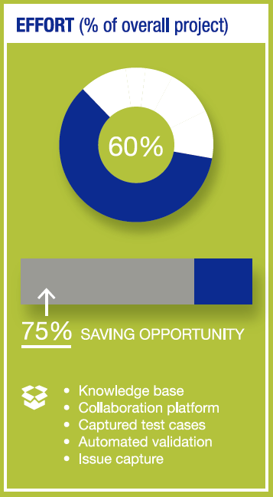
The Road to HANA
UAT
Live
CRP 2
SIT
CRP 3
CRP 1

Slide 6
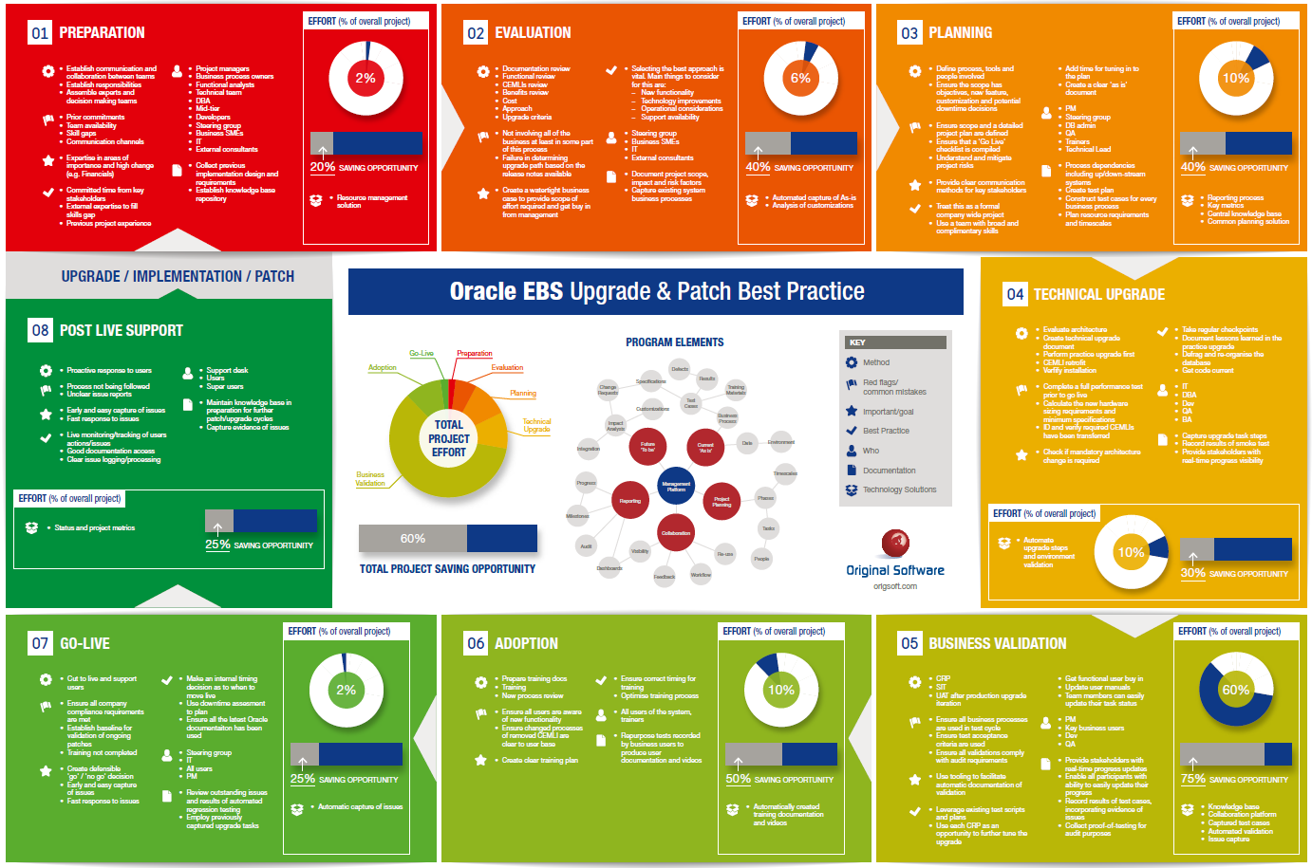
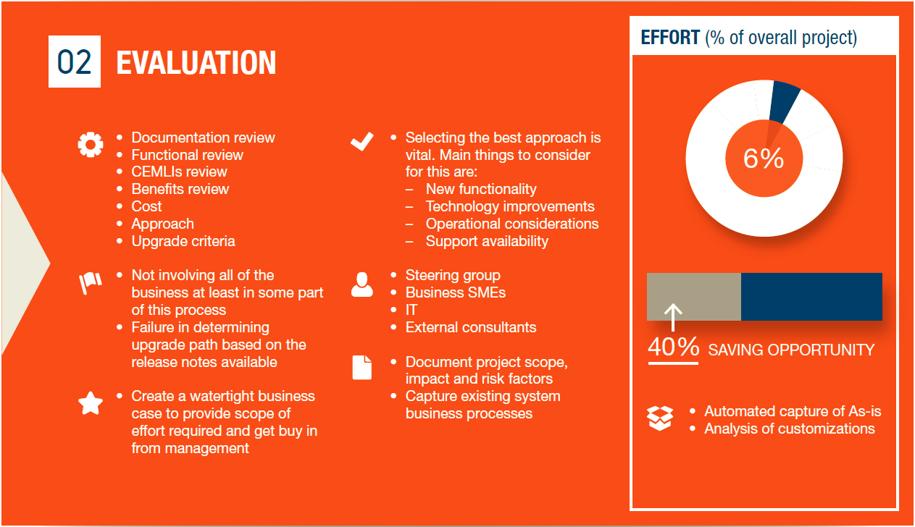
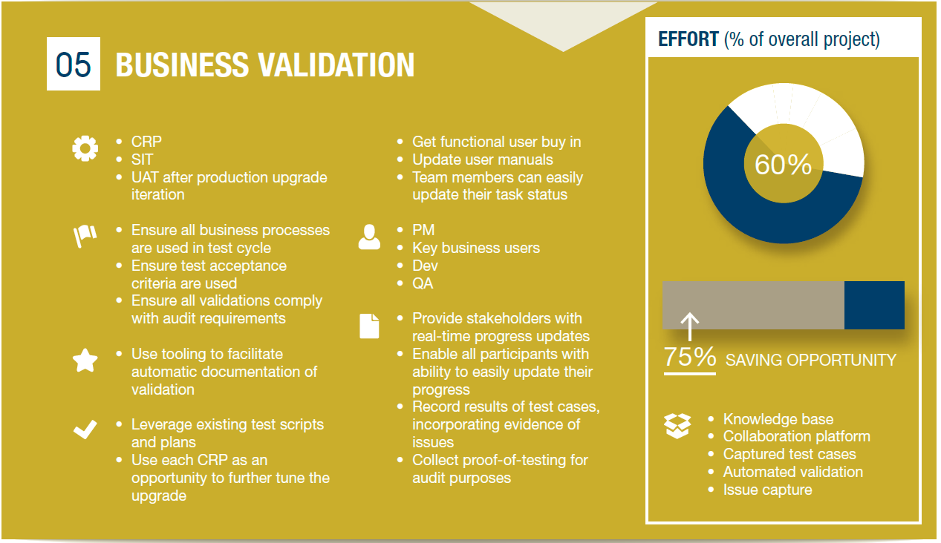
Methodology
Implement – Prove – Adopt – BAU

Slide 7
The Risks
“If this doesn’t work, we’re dead.
Dead in the water.”
At worst?
Nothing works
At best?
Significant business disruption
But success and a secured future
Hasso Plattner, Chairman of the Supervisory Board of SAP

Slide 8
Definition of Quality?
It compiled
It does not crash
No bugs
It works
The users are happy
...or they have stopped moaning anyway
It does what it needs to, the users know how to use it, improves their efficiency and is safe. It adds value to the business.

Slide 9
Keys to Quality
Plan and manage
Document the As-Is
Perform the migration
Configure and model the new processes
Validate
SIT, CRPs UAT
Project review
Support live users

Slide 10
The Danger – it gets harder!
Notes:
The migration is really a series of upgrade projects.
The danger is that each migration ends up being a larger project than the one before.
Why?
For each new module you implement, almost all of the rest is impacted and therefore requires testing.
If you don’t have a repeatable, measurable process in place each migration is like starting from scratch.
So what can you do?

Slide 11
Planning and Automation – Gets easier

Slide 12
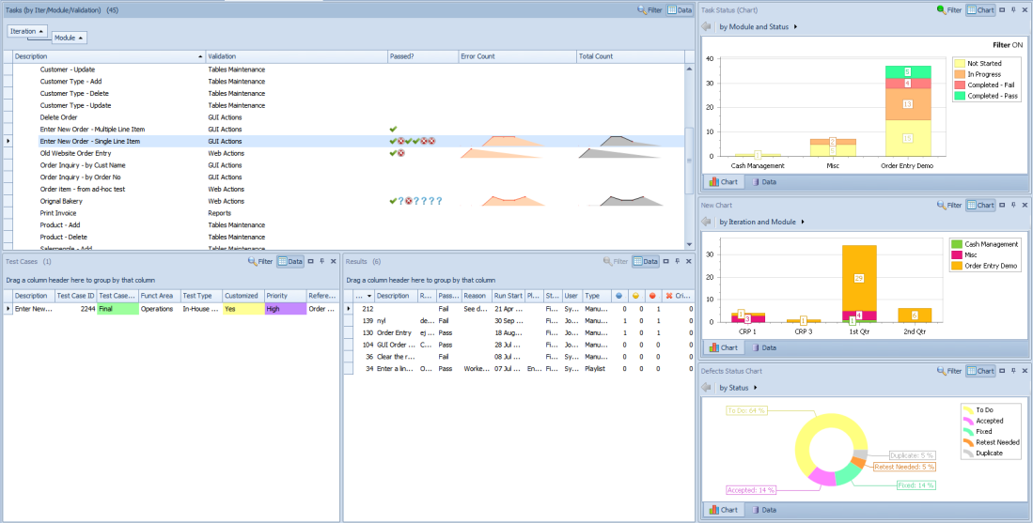
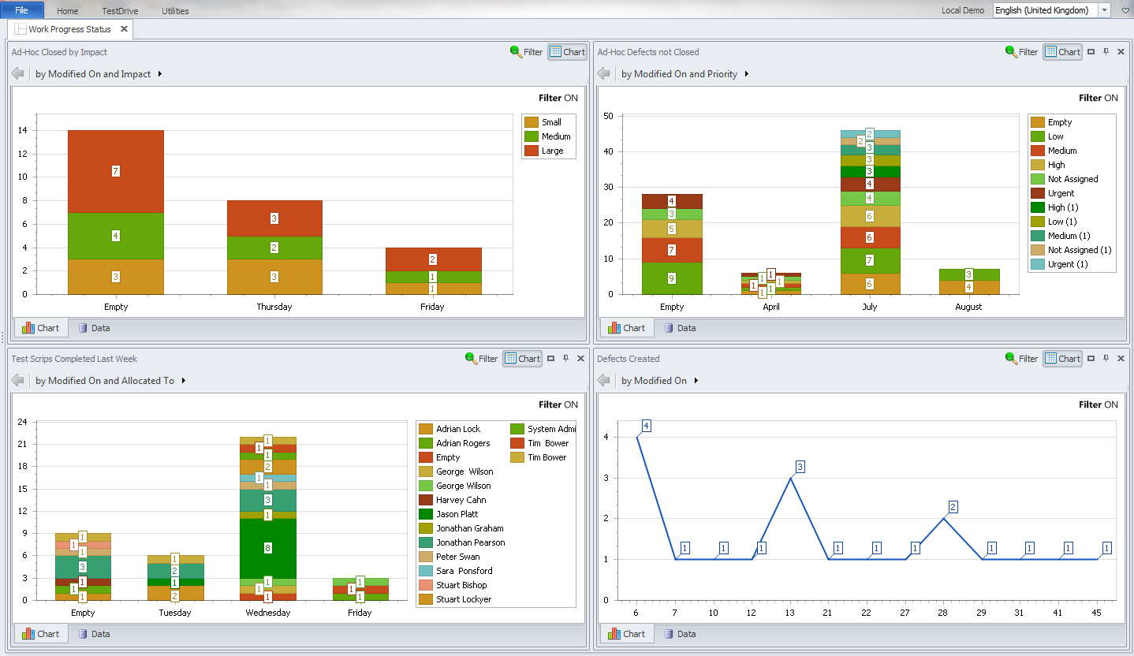
Management platform
Communicate
Assets
Design docs
Plan
People, roles
DO
Tasks
Requirements
Test Cases
Scripts
Time
Phases
Tasks
Testing
Workflow
Make
Manage
Report
Test Cases
Results
Defects
Status
Progress
Methodologies
Metrics
Dashboards
Burndown
Audit

Slide 13
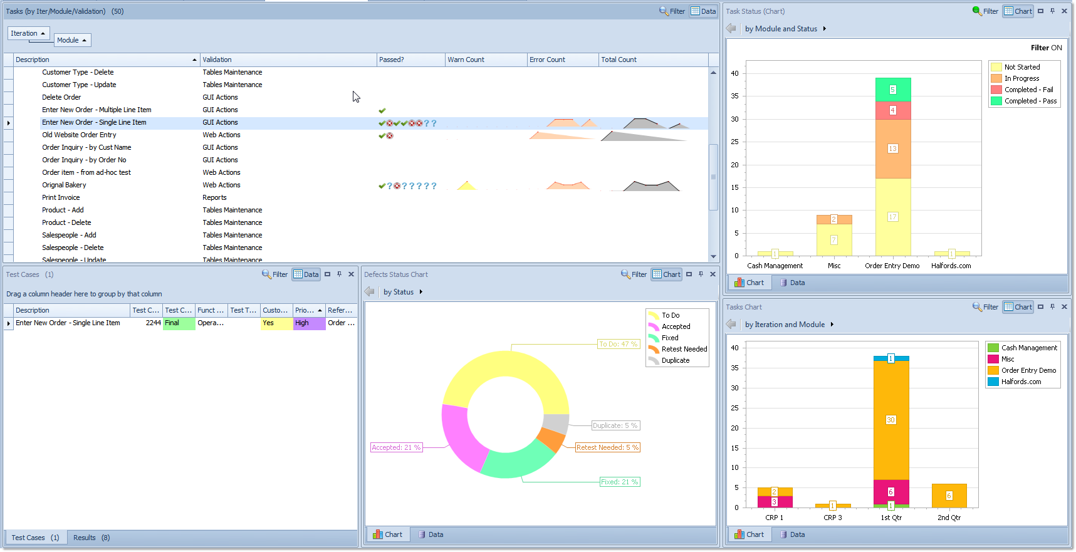
Dashboard

Slide 14
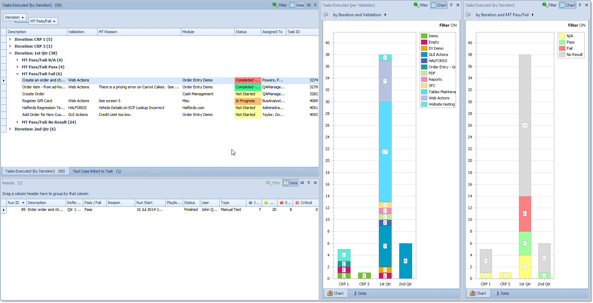
Work Management

Slide 15
Defect Tracking

Slide 16
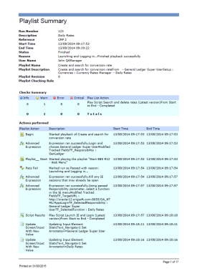
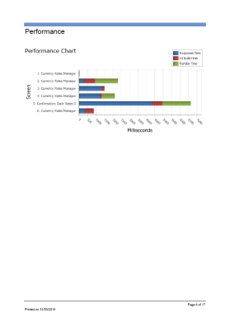
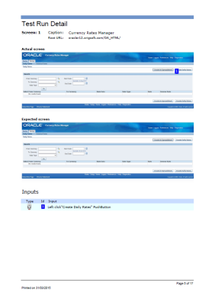
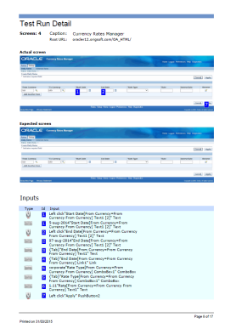
Business Process Capture
Diagnostics
Test Script
Test/audit report
Training video
Automated scripts
Easy to learn and use
Immediate time-saver

Slide 17
Capture Business Process

Slide 18
Capturing the As-Is - The “SAP Selfie”
“The consultants from Original Software showed us how we could automatically record transactions and processes from our SAP software”
“For the SAP upgrade project, because we had no formal test scripts and were starting from scratch, we could see it would be an extremely powerful way of building a test library”

Slide 19
Documentation

Slide 20
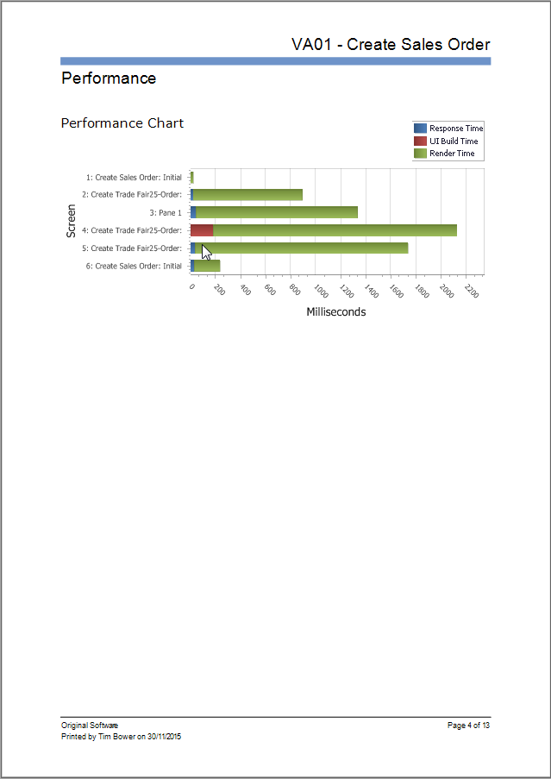
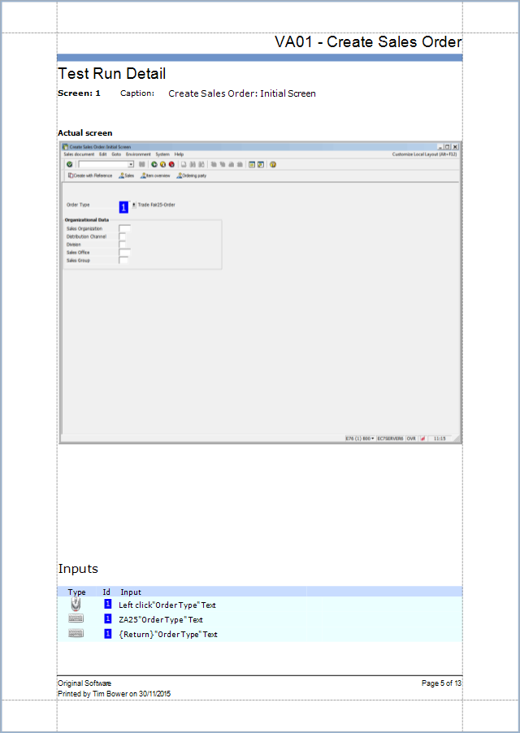
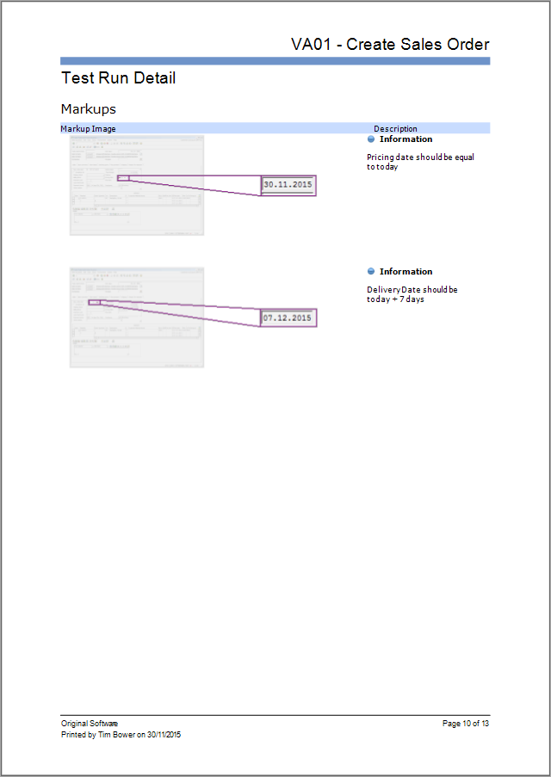
Documentation and Training Material

Slide 21
Training Materials

Slide 23
Automated Testing and Validation

Slide 25
Validation – Automation
“The problem with most test systems is that you have to employ specialist programmers, which we just couldn’t justify. I wanted a solution that was easy to deploy and use”

Slide 26
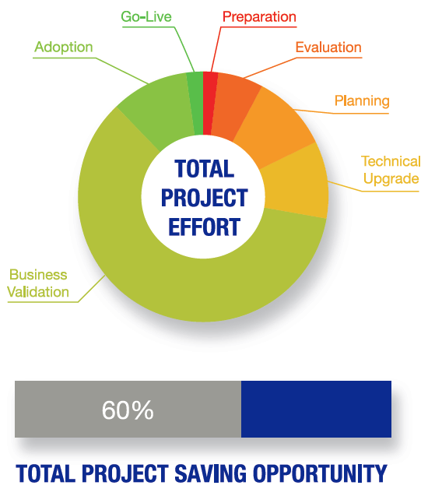
Total Project Savings
Eliminate risk
Meet business/project deadlines
Reduce cost by > 30%
Notes:
Using the correct tooling there is a massive opportunity for time and cost savings
This information is gathered from customers who have performed large SAP, EBS and other ERP upgrades and migrations
Eliminate risk - Upgraded applications continue to meet business requirements
Meet business/project deadlines - Lift moratorium on business enhancements
Reduce cost by at least 30% - Reduce number of CRPs
Where do these savings come from? They come at all stages of the process. However, the largest saving opportunity is in the Validation stage.

Slide 27
Thank you for listening
www.origsoft.com
It’s Q & A time….
origsoft.com/contact | UK +44 (0)1256 338666 | USA +1 630 321 0092 | solutions@origsoft.com

